Slide 1
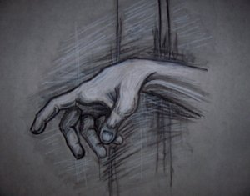
Metacarpal &Phalangeal Fractures
Dr. Alaa Abdulhussein Dawood
Assistant professor Orthopedic Surgery
Medical College ,Basrah University

Slide 2
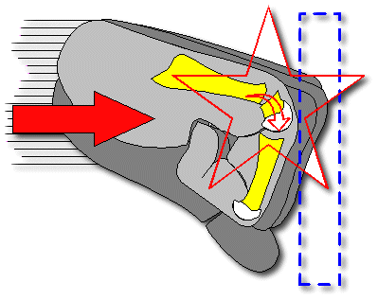
Metacarpal fracture
Caused by blow, fall , or longitudinal force (boxers punch).

Slide 3
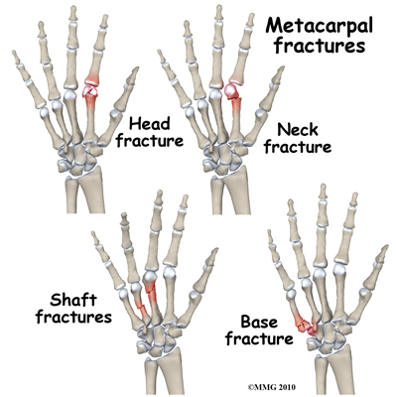
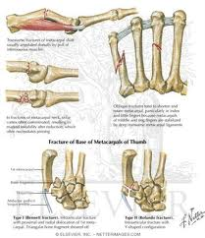
Metacarpal fracture
Site : base ,shaft , neck .

Slide 4
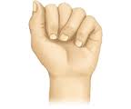
Metacarpal shaft fracture
Deformity :
1)Angular :{transverse#} not very marked ,doesn't interfere much with function.
2) Rotational :{spiral #}serious ,malrotation will result in overlap of fingers when patient closes the fist

Slide 5
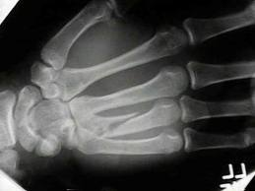
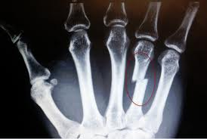
Metacarpal shaft fracture
Transverse: caused by direct blow
Spiral : caused by twisting or punching force.
TRT :Transverse #:1) slight displacement ;just crepe bandage .
2)Considerable displacement :closed reduction & plaster slab for 3 weeks .If reduction is unstable ,then open reduction & internal fixation by plate& screws ,or percutaneous k –wire across the fracture line.
Spiral # :liable to rotate so treated by open reduction& internal
fixation
Transverse #
Spiral #

Slide 6
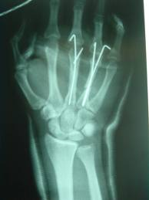
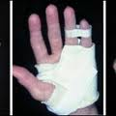
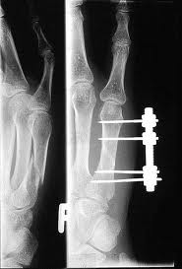
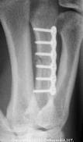

Slide 7
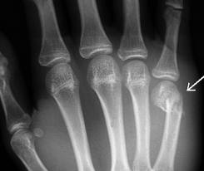
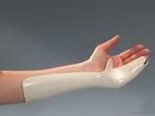
Metacarpal neck (boxer #)
Usually the fifth finger.
Usually local swelling with flattening of the knuckle.
X-ray :transverse #, impacted with volar angulation of the distal fragment.
TRT:middle finger ,no more than 20⁰ angulation can be accepted.
IF reduction
Ringe& Littile finger
*Up to 40⁰ angulation deformity can be accepted, apply gutter plaster with Mp joint flexed & Ip joints extended for 2 weeks .
Index & is needed, try closed reduction under L.A followed by immobilization in a gutter plaster .
For unstable frcactures do open reduction &internal fixation by K-wires

Slide 8
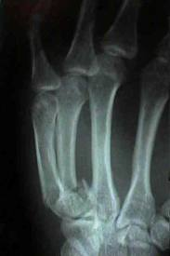
Metacarpal Base Fracture
Except 1st metacarpal (thumb), these are stable fractures ,treated by volar slab ,extending from the forearm to PIP joint for 3 weeks .Just ensure that rotation is corrected .
Displaced intra articular # of the base of 4th &5th Metacarpal: these are mobile joints, so joint incongruity will be painful ,so do closed reduction &percutaneous k-wire or compression screw.

Slide 9
Fracture of thumb metacarpal base
Impacted fracture of the MTC base .
Bennet’s fracture dislocation of carpometacarpal joint.
Rolando’s comminuted fracture of the base .

Slide 10
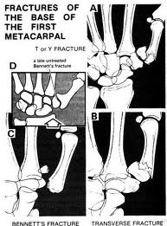
1)Impacted fracture : Transverse fracture 6 mm distal to carpometacarpal (CMC)joint .
TRT :<20-30 ⁰ angulation ,apply thumb Spica for 2-3 weeks. > 30⁰angulation , do closed reduction &thumb spica

Slide 11
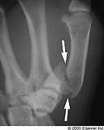
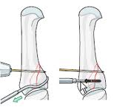
2)Bennet’s fracture
Oblique fracture ,extend into carpometacarpal
joint(intra articular) & is unstable.
TRT :1) Try closed reduction &POP cast.
2)If failed ,do closed reduction &
percutaneous K wire fixation, or open
reduction & internal fixation by
compression screw.

Slide 12
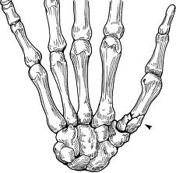
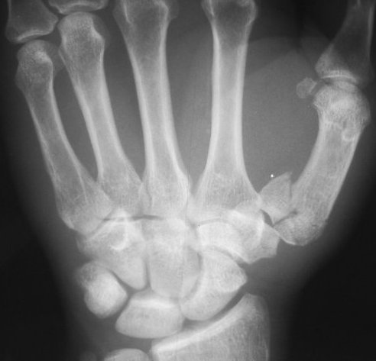
3)Rolando’s fracture :Comminuted intra-articular fracture of the base of 1st metacarpal
TRT :1)closed reduction &k-wire fixation
2)external fixation for more sever comminution

Slide 13
Fracture phalanges
Cause : Direct trauma .
Fracture proximal & middle phalanges :
Transverse fracutre :usually angulated
Spiral fracture :rotation deformity
Comminuted fracture(tendon damage & skin loss ).
Avulsion fracture:of small fragment of bone.
Intra-articular fracture :

Slide 14
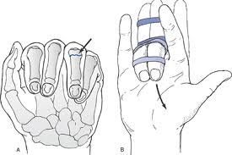
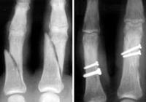
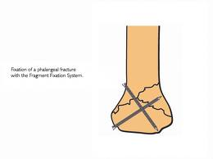
Treatment:
Undisplaced fracture : functional splintage by strapping the fractured finger to its neighbor (buddy strapping ) .
Displaced fracture : reduced ; correct rotation & angulation . Apply dorsal splint with MP joint in 80⁰
flexion & IP joint in extension for 3 weeks .
Indication for internal fixation :
1) Closed reduction cannot be achieved .
2)Unstable # .
3)Intra-articular #.

Slide 15
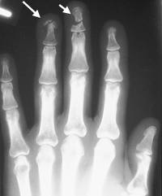
Fracture distal phalanx :
Fracture of the tuft : finger tip struck by hammer, or caught by a door ,the bone shattered .
TRT : disregard the fracture , control swelling & regain movement . Painful hematoma beneath finger nail should be drained .

Slide 16
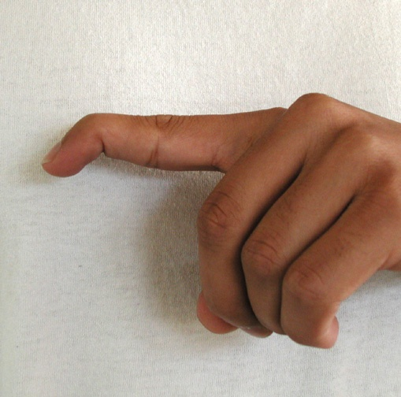
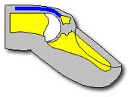
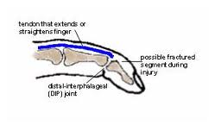
Mallet finger injury (base ball finger) :
Cause :1) rupture of extensor tendon at or near its
insertion at terminal phalanx .
2)avulsion fracture of the base of terminal phalanx .
C/F : Terminal phalanx drops & patient unable to
straighten it

Slide 17
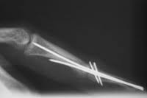
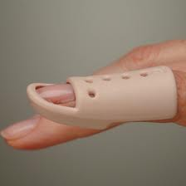
TRT :
Tendinous avulsion : splint DIP joint in hyperextension, using a special splint, constantly for 8 weeks , then only at night for 4 weeks .
Bony avulsion : also splint DIP joint in hyperextension for 6 weeks . For large bony avulsion associated with subluxation of DIP joint ,fixation of the fragment with K wire or a small screw .

Slide 18
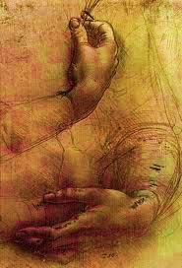
Dislocations in the Hand

Slide 19
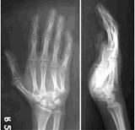
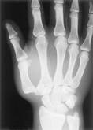
Dislocations in the hand
Carpo metacarpal dislocation :Mostly in the thumb , it
Resembles Bennetts fracture dislocation .
TRT : closed reduction is easy , but unstable , so; fix by k wire which is kept for 5 weeks but protective splint should worn for 8 weeks (risk of instability)

Slide 20
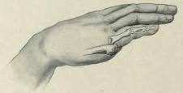
Metacarpo-phalageal dislocation
Usually the thumb , sometimes the 5th finger.
The finger is suddenly forced into hyper extension .
TRT: trial of closed reduction (usually difficult to reduce). If failed then open reduction through dorsal approach .

Slide 21
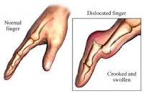
Interphalangeal dislocation
Distal interphalangeal dislocation is rare .
Proximal interphalangeal dislocation is more common
Mechanism : hyperextension force .
TRT :
* closed reduction (easily done ) , strapping the finger to its neighbor for few days .
* If there is # fragment which is big &associated with dislocation , open reduction of the fragment & fixation by small screw or k-wire

Slide 22
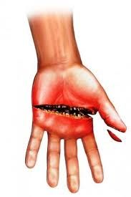
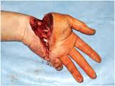
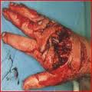
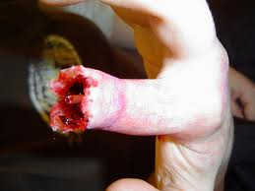
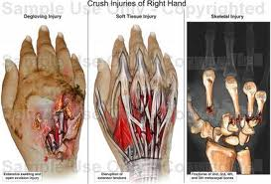
Open hand injuries
Very common .
Types :
1) Tidy or clean cuts
2)Laceration
3) Crushing or injection injuries
4)Burns &finger bulb defects

Slide 23
Clinical assessment :
Mechanism : instrument; Sharp or blunt ?? Clean or
dirty?? Severity ?
Position of the fingers: (flexed or extended??)at injury.
Timing :
Age : of the patient
Occupation :
Dominancy : right or left handed

Slide 24
Clinical examination
Skin : assess the degree of skin damage
small wounds ,be alert!!, possibility of misdiagnosis
Circulation : careful evaluation of the state of hand
circulation, Perform (Allen test) .
Nerve examination : assess function of the peripheral nerves.
Tendon: assess the function of extensor tendons&
long flexor tendons .
Bones : any fractures

Slide 25
X-ray : AP , lateral & oblique view.
PRIMARY TREATMENT :
Preoperative care :
Treatment of pain & shock
Wound rinsed with plenty of normal saline
Antibiotics
Anti tetanus &Anti gas gangrene prophylaxis
Wound dressed &hand splinted

Slide 26
Wound exploration:
Under G.A , skin debrided but here skin is very precious , original wound is enlarged (must not cross skin creases )
Dead muscle excised, wound irrigated with saline
Further assessment of extent of injury .
Tissue repair :
# reduced & fixed by k-wire or external fixation .
Joint ligament &capsule : repaired
Artery& vein :repaired if the hand or finger is ischemic
Nerves: repaired (operating microscope)

Slide 27
Extensor tendon :repaired
Flexor tendon : repair is more challenging .
Closure :unless wound contaminated ,skin is closed by
direct suture without tension or, if there is skin loss ,by skin grafting or local flaps .

Slide 28
Thank You
شــــــــــــــــــكرآ
Merci Beaucoup

